Slide 1
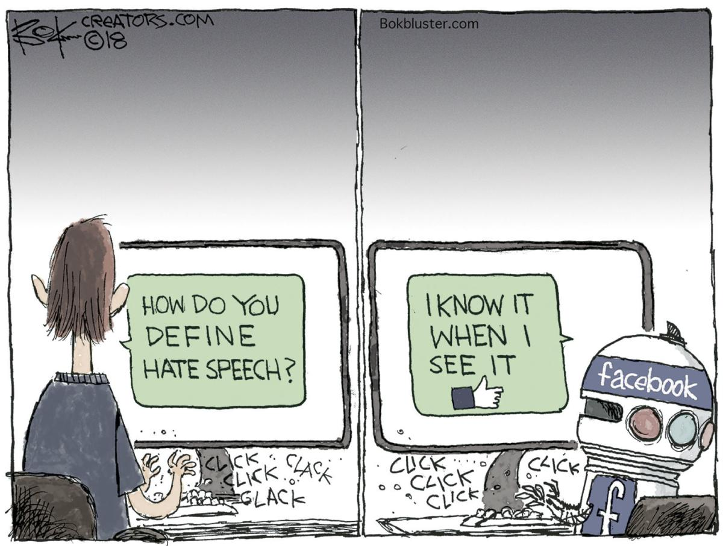
#hate
speech recognition

Slide 2
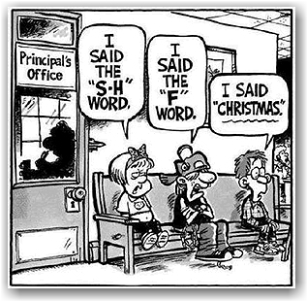
#overview
The What
Twitter - largest microblogging website in the world - 330 million global users
Content is mostly unrestricted
The Supreme Court has never created any category of speech that is defined by its hateful conduct.
So what is hate speech?

Slide 3
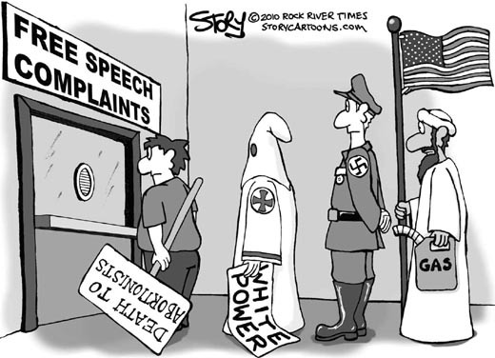
Hate speech is defined as abusive or threatening speech that expresses prejudice against a particular group, especially on the basis of race, religion, or sexual orientation
What is considered ‘hate speech’ is a fine line between the first amendment and harmful conduct unto others
With this project, we hope to determine what can be classified as hate speech

Slide 4

#inspiration
The Why
59% of Americans believe online hate and harassment make hate crimes more common
22% feel less safe in their community because of online hate
85% want the government to act by improving training and resources for police on cyber hate

Slide 5
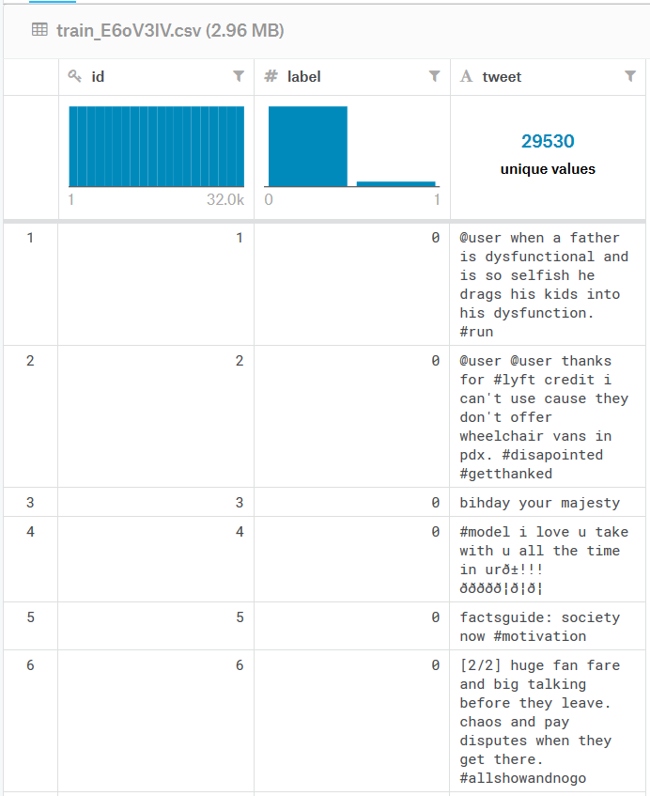

#data
31935 records
29,695 Non-Hate Labeled Twitter Data (93%)
2240 Hate Labeled Twitter Data
(7%)
Source: https://www.kaggle.com/vkrahul/twitter-hate-speech

Slide 6
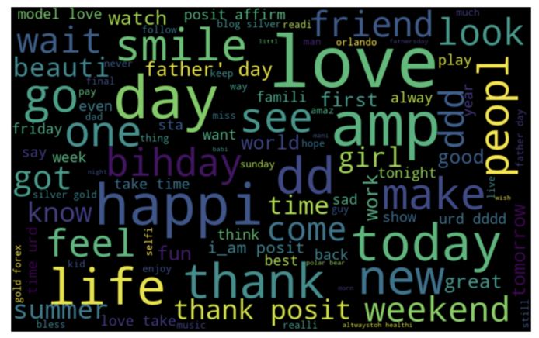
#positive_word_cloud

Slide 7
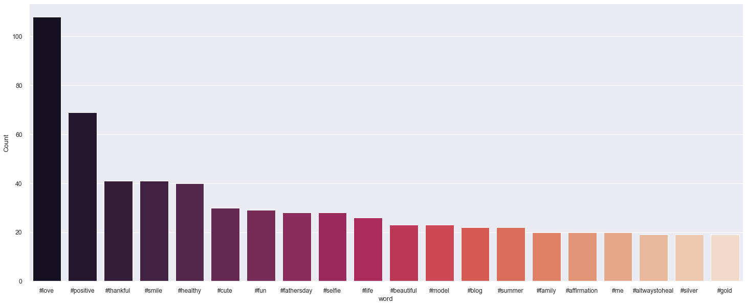
#top20_positive_hashtags

Slide 8
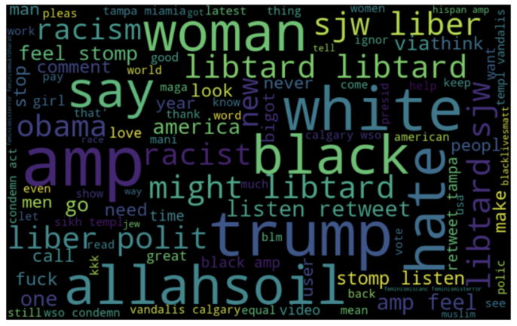
#negative_word_cloud

Slide 9
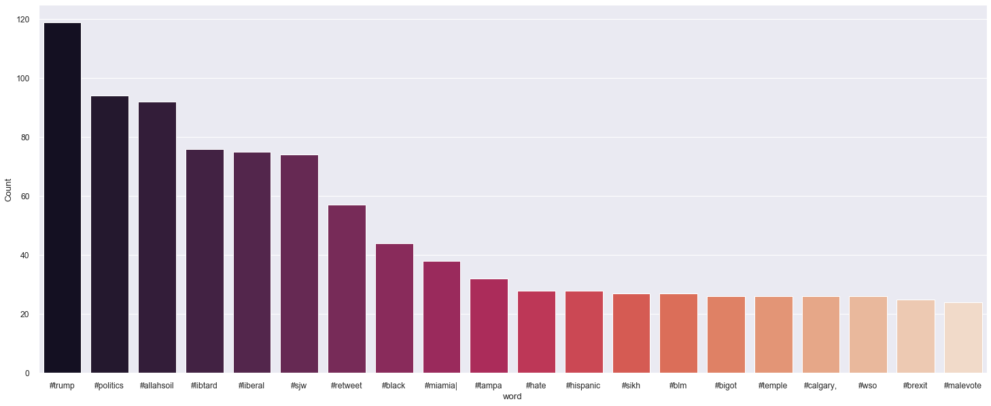
#top20_negative_hashtags

Slide 10

The #how

Slide 11
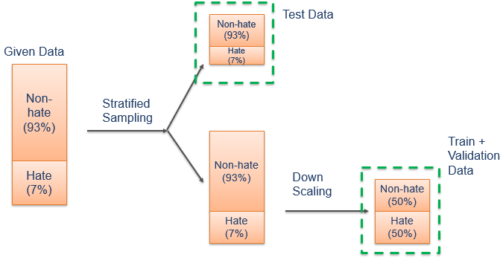
#data architecture
We had 93% of Non-Hate tweets and 7% Hate tweets
We downscaled to remove the bias

Slide 12
#our_approach
Our Approach
Bag of Words
Top 1000 Words - BOW
TF-IDF
Top 1000 words - TFIDF
Logistic Regression
Decision Tree
Random Forest
Naive Bayes
Gradient Boosting

Slide 13
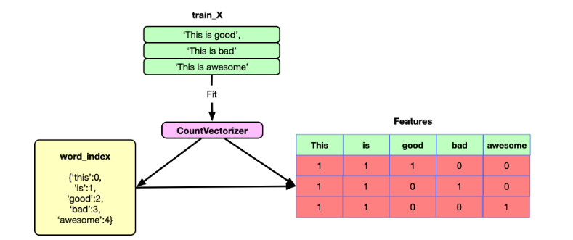
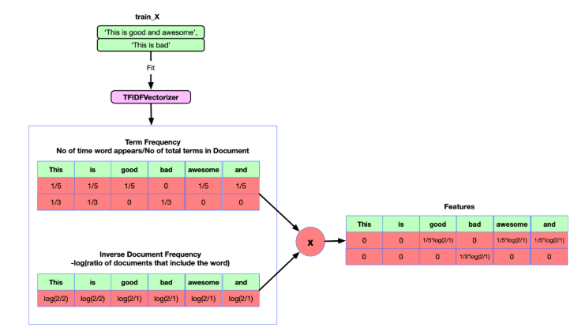
#bag_of_words
#term_frequency_inverse_document _frequency

Slide 14
#data #cleaning

Slide 15

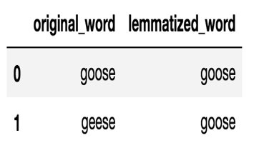
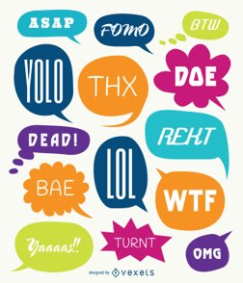

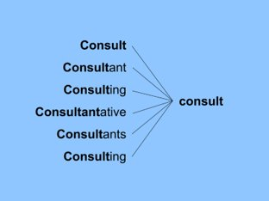


#LEMMATIZATION
#SLANG_WORDS
#STEMMING
#STOPWORDS
#GREEK_CHARACTERS

Slide 16
#accuracy?
#recall?

Slide 17
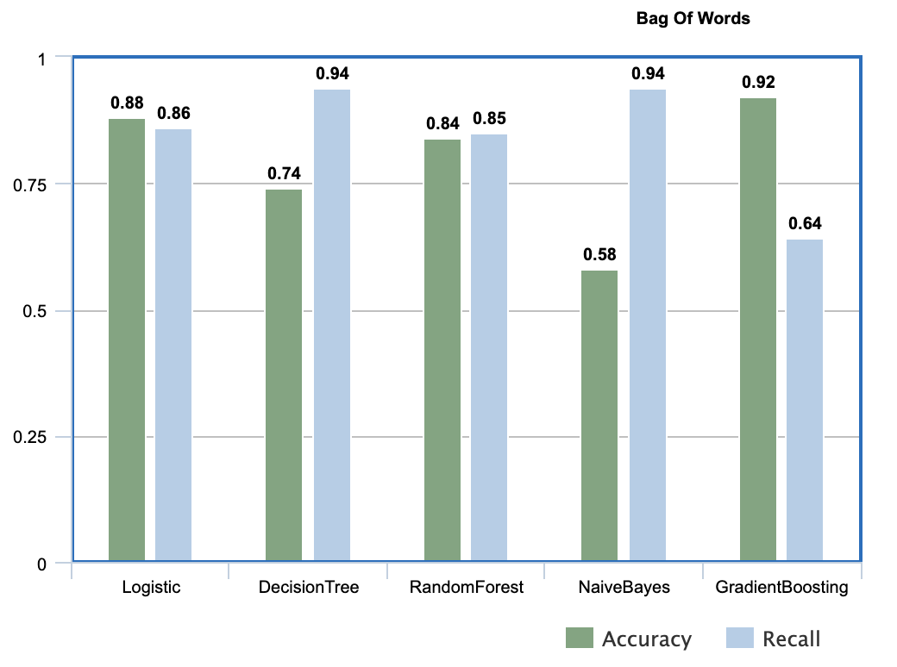
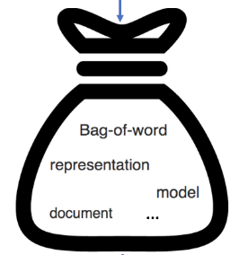
#Bag_of_Words

Slide 18
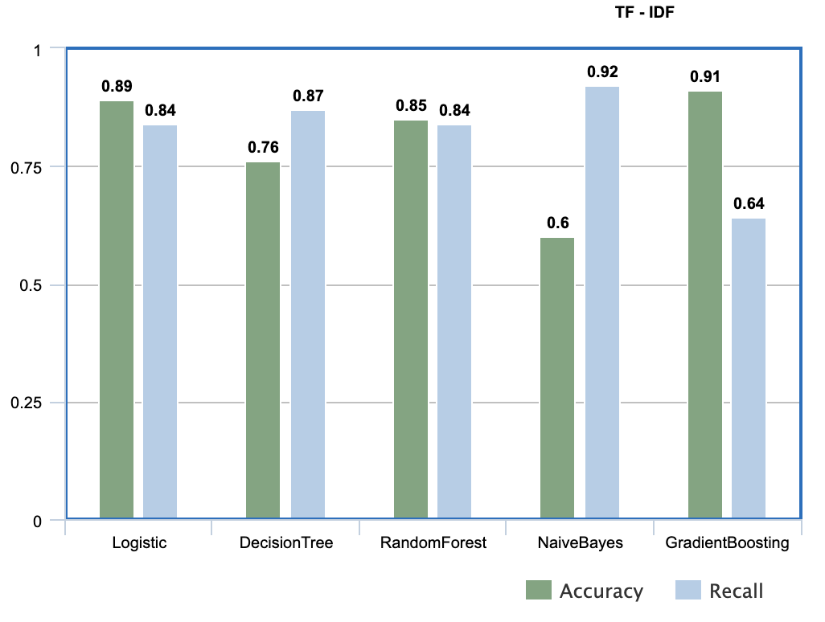
#TF_IDF

Slide 19
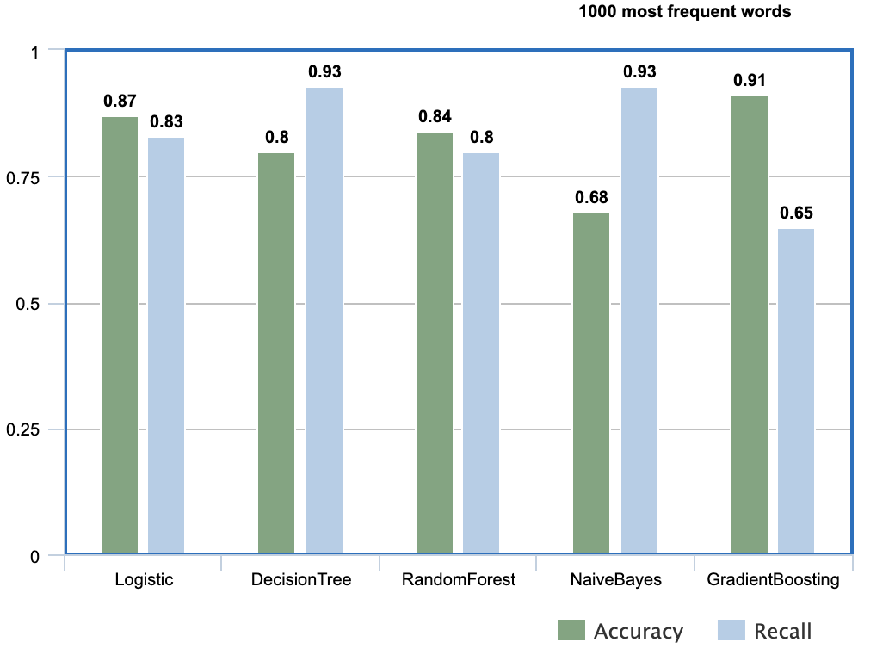
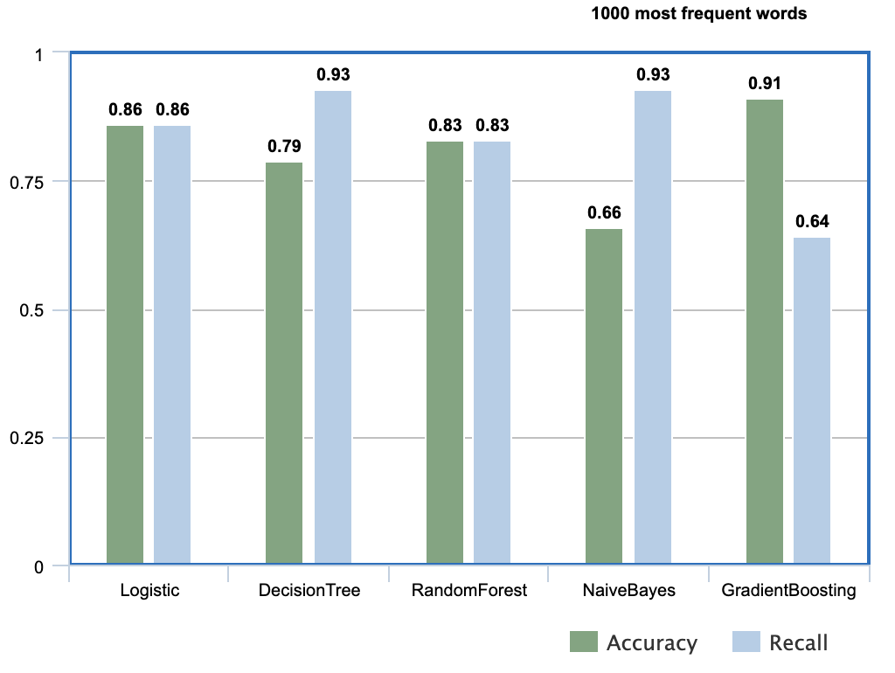
#1000_most_frequent_words
#TF_IDF
#Bag_Of_Words

Slide 20
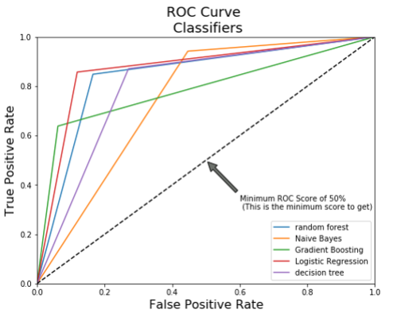
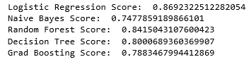
#ROC_curves_for_Bag_of_Words_approach
AUC

Slide 21
#key_insights
Politics, race and sexual tweets form a major chunk of hate tweets
Results obtained when we played around with an imbalanced data set were inaccurate. The model predicts new data to belong to the major class in the training set due to the skewed nature of the train data.
The weighted accuracy of a classifier is not the only metric to be looked at while evaluating the performance of the model. Business context plays a vital role as well.

Slide 22
#challenges #future_steps
Change in attitude towards topics over time and historical context.
“The Nazi organization was great.”
Automatic hate-speech detection is a closed-loop system:
Hate verbiage is not restricted to text. Future prospects include recognising hate portrayed through pictures.

Slide 23







#team
#adwait #vedant #sushrut #sneha #rishab #tanvir #chavi

